Slide 1
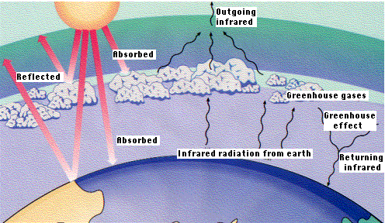
Layer Model

Slide 2
Take home points from Chapter 2
EMR carries energy through space
If an object can absorb energy, it can also emit energy.
Objects emit at a rate equal to T⁴

Slide 3
Layer Model
Algebraic calculation of the effect of an IR absorber (a pane of glass) on the equil. T of the Earth.
Not accurate or detailed
Not used for global forecasts

Slide 4
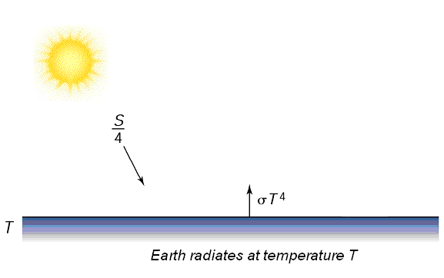
Bare Rock Model
No atmosphere no cloud
T of Earth is controlled by the ways that energy comes from the Sun and is re-radiated to space as IR.
Energy and T relation
See SB law

Slide 5
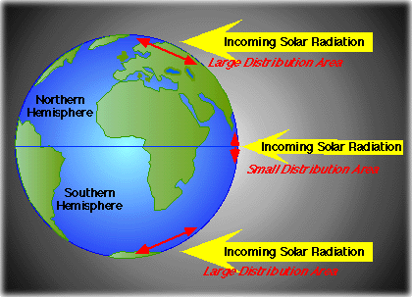
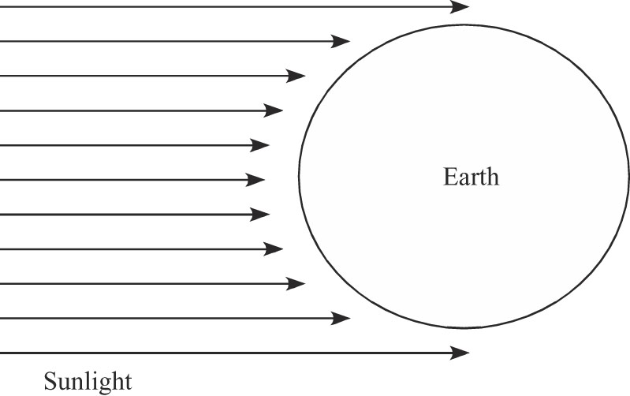
What area do we use?
Sun shines on half the Earth
Light is weaker/stronger
latitude, dawn/dusk
Solar Constant
Day
Night

Slide 6
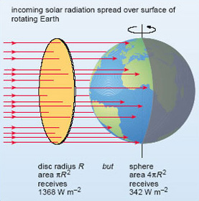
Sunlight hits Earth from same direction, makes a circular shadow, use the area of a circle, not a sphere.
Solar Constant
Day
Night
Area (m²) = πr²_{earth}
Earth receives influx of energy equal to the intensity of sunlight multiplied by the area of a circle = πr²_{earth}
F_{in} = πr²earth I_{in}

Slide 7
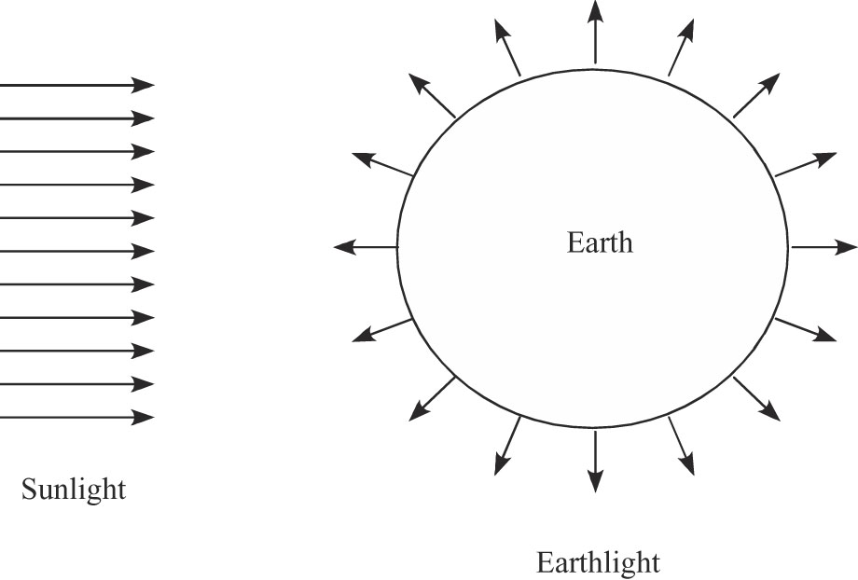
As we did for solar energy, need to convert intensity, I, to flux, F, by multiplying by area.
What area do we use?
Energy leaves in all directions
So, we need the area of a sphere;
A_{sphere} = 4 πr²_{earth}
_{Total Energy Flux from Earth}
F_{out} = 4 πr²_{earth}εσT⁴_{earth}

Slide 8
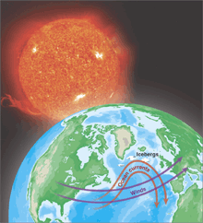


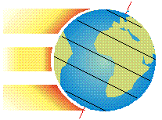
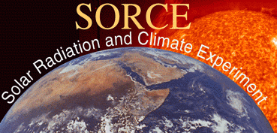
Q1: What would be Earth’s equilibrium temperature without an atmosphere?
Assumption: energy in = energy out
F_{in} = F_{out}
Thermal equilibrium:
Power received from Sun = Power emitted by Earth
π R²_{Earth} S = 4π R²_{Earth} σ T⁴
where S = solar intensity at Earth = 1370 W/m² and the Boltzmann constant σ = 5.67 x 10⁻⁸ W/m²K⁴
σ T⁴ = S/4
Modified from Kump, Kasten, and Crane, The Earth System, 2d Ed., Pearson Prentice Hall 2004

Slide 9
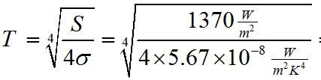


Q1: What would be Earth’s equilibrium temperature without an atmosphere?
T⁴ = S/4 →
Reality check: This is very cold!
we have neglected a big effect – Earth’s atmosphere reflects a significant amount of the Sun’s incoming radiation.
What do you predict we will find for the Earth’s equilibrium temperature if we take cloud reflection into account?
A warmer or colder planet?

Slide 10
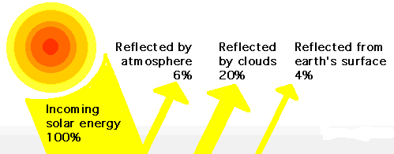
Hypothesis 1: Clouds warm Earth Hypothesis 2: Clouds cool Earth
Both are partly right…

Slide 11
Simple model of Earth T
Assumption: energy in = energy out: -F_{in} = F_{out}
Incoming sunlight = I_{in} = 1350 W/m²
solar constant
Albedo = reflected light = α
Not absorbed and re-radiated as IR
Just ‘bounces’ back
Earth = 0.30 - clouds, snow, ice
Venus = 0.70 - sulfuric acid clouds
But carbon dioxide creates gh effect, T 758 deg K
Mars = 0.15 - no clouds
Some carbon dioxide, T 253 K (afternoon)

Slide 12
Incoming solar energy not reflected
Albedo = reflected light = α= 30%
1350 W/m² (1 - α) = 1000 W/m²
Want flux for the whole planet (no m²)
F_{in}(W) = I_{in}(W/m²) x Area(m²)

Slide 13
Put them together, total incoming flux is:
First layer model has no atmosphere, just a bare rock!
F_{in} = πr²_{earth} (1 - α) I_{in}
I_{in} = 1350 W/m²
Reduce by albedo to 1000 W/m²
Multiply by area of circle to get Flux (W)
Rate at which Earth radiates energy is given by SB law:
F_{out} = Area x εσT⁴_{earth}
ε = emissivity, 0 to 1, unitless
ε = 1 would be a blackbody

Slide 14
As we did for solar energy, need to convert intensity, I, to flux, F, by multiplying by area.
What area do we use?
Energy leaves in all directions
So, we need the area of a sphere;
A_{sphere} = 4 πr²_{earth}
_{Total Energy Flux from Earth}
F_{out} = 4 πr²_{earth}εσT⁴_{earth}

Slide 15
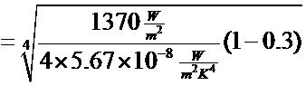


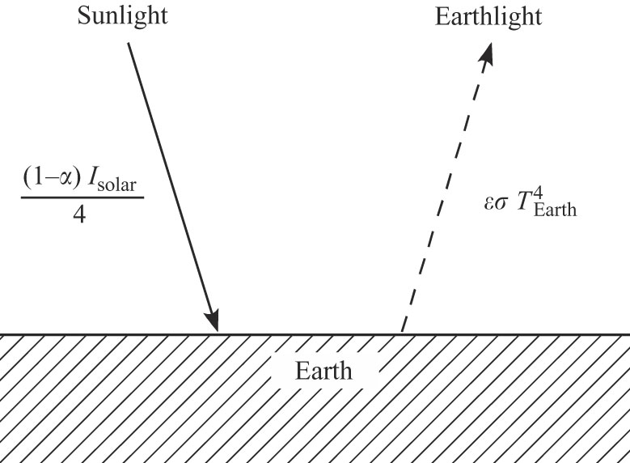
F_{in} = F_{out}
πr²_{earth} (1 - α)I_{in =} 4 πr²_{earth}εσT⁴_{earth}
εσT⁴_{earth} = (1 - α) I_{in}
4
T _{earth} = 4 (1 - α) I_{in}
4εσ
Flux in
Flux out
No atmosphere
εσT⁴earth

Slide 16
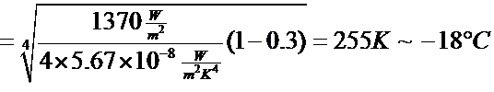
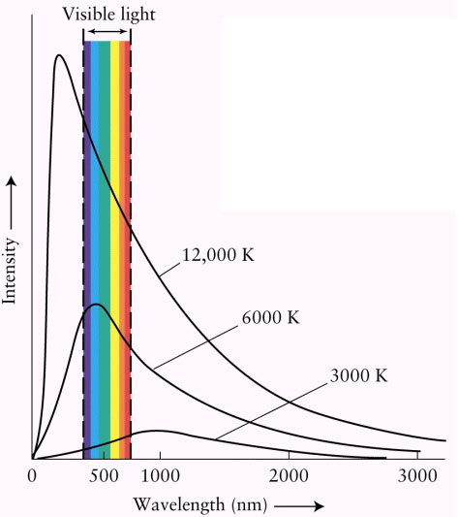
T _{earth} = 4 (1 - α) I_{in}
4εσ
εσT⁴earth
Solar intensity
Albedo
a bare rock!
Reality check: The Earth is not really this cold! Its average surface temperature is actually about T = 15º C.
What’s missing from this model? Brainstorm ideas, and we will analyze some of them quantitatively.

Slide 17
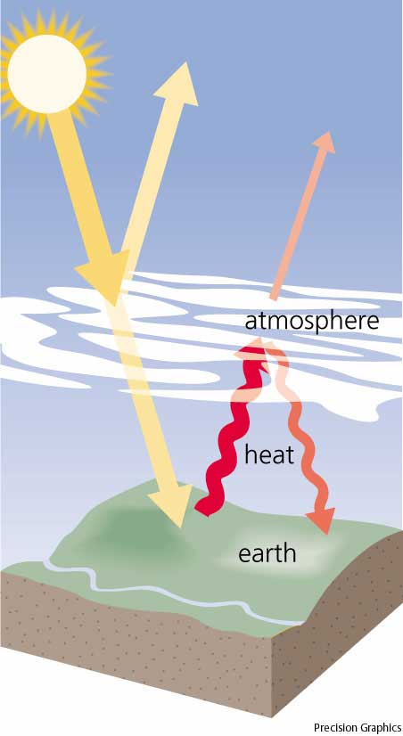
Q2: What effect do greenhouse gases have on Earth’s equilibrium temperature?
Clouds do not merely reflect and transmit solar radiation – they also absorb Earth’s thermal radiation and re-radiate, especially in longer wavelengths.
One-layer model: Assume the atmosphere absorbs all the Earth’s radiation,
and re-radiates half of it back down to Earth (and half out to space), at an equilibrium temperature T_{e}.
Find Earth’s Surface temperature T_{s}.
http://www.yourdictionary.com/ahd/g/g0258400.html

Slide 18
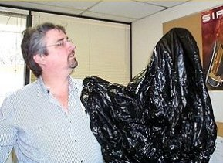
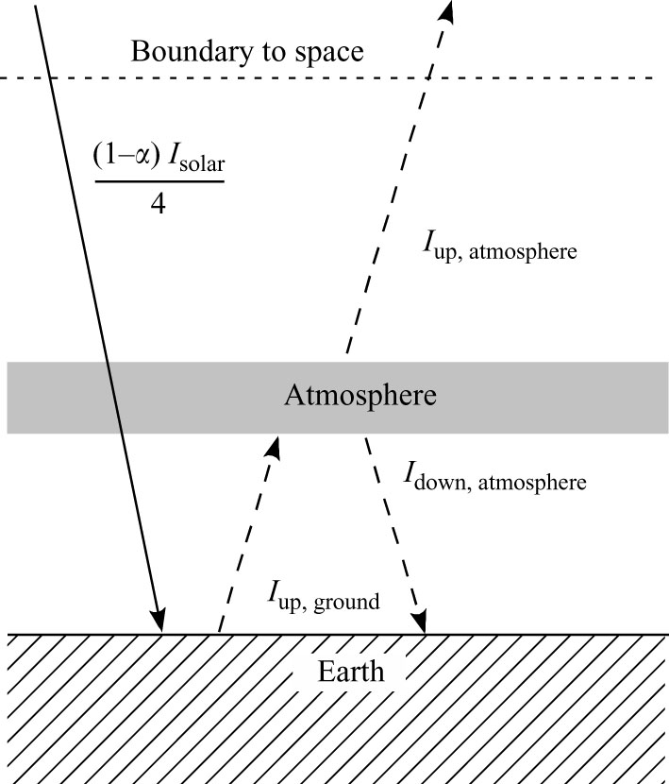
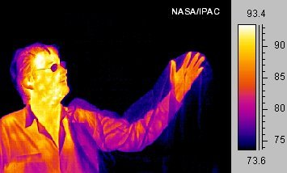
Need a model with a single pane of glass as its atmosphere
Simple model lacks gh effect

Slide 19
Layer Model with GH Effect
Energy diagram for a planet with a single pane of glass for an atmosphere.
Glass is transparent to incoming VIS but a blackbody to outgoing IR
IR
VIS
IR
IR

Slide 20
Incoming VIS passes thru atm, absorbed by surface
Surface radiates IR as εσT⁴_{ground}
I_{up,ground}, which is entirely absorbed by atm
Atm has a top and bottom, so
it radiates energy up and down:
I_{up,atm}
I_{down ,atm}
εσT⁴ground

Slide 21
The model assumes that the energy budget is in a steady state: energy in = energy out
This applies to individual pieces of the model as well.
So energy budget for atm:
I_{up,atm} + I_{down,atm =} I_{up,ground}
(units are Watts/Area)
Or,
2εσT⁴_{atm} = εσT⁴_{ground}
2εσT⁴atm
εσT⁴ground

Slide 22
Budget for the ground is different now because we have heat flowing down from atm.
We still assume the energy budget is in a steady state: I_{in} = I_{out}
So the component fluxes are:
I_{up,ground} = I_{in,solar} + I_{down,atm}
_{(units are Watts/Area)}
Or,
εσT⁴_{ground} = (1−α) I_{solar} + εσT⁴_{atm}
2εσT⁴atm
4
εσT⁴ground

Slide 23
Finally, a budget for the Earth overall:
Draw a boundary above the atm and figure that if energy gets across the line in, it’s flowing out at the same rate.
I_{up,atm} = I_{in,solar}
The intensities are comprised of
individual fluxes from the Sun and
the atmosphere.
εσT⁴_{atm} = (1−α) I_{solar}
In = Out
2εσT⁴atm
4
εσT⁴ground
Page 25

Slide 24
Budget for the Earth overall:
εσT⁴_{atm} = (1−α) I_{solar}
One unknown is T_{atm}
If we solve for T_{atm} we get the
same answer as solving for
T_{earth} in the bare planet model.
This is an important point!
4
In = Out
2εσT⁴atm
εσT⁴ground

Slide 25
It tells us that the place in the Earth system where the T is most directly controlled by the rate of incoming solar energy is the T at the location that radiates to space.
This is called the
skin temperature of the Earth.
(it’s equal to the outer most T_{atm})
Now that we know this we can
plug that into the budget eqn
for the atm.
Page 25 - 26
In = Out
2εσT⁴atm
εσT⁴ground

Slide 26
And see that: (page 26)
2εσT⁴atm = εσT⁴ground
Or,
T_{ground} = 2T_{atm}
This means that the T of the ground must be warmer than the skin T by a factor of the fourth root of 2, an irrational number that = 1.189. (~19%)
Fourth root of 2 = ± 1.189207
T_{atm}
4
2εσT⁴atm
Warmer by about 19%
εσT⁴ground

Slide 27
Q2: What effect do greenhouse gases have on Earth’s equilibrium temperature?
Eliminate σ T_{e}⁴ from the two equations and solve for Earth’s T_{s}:
σ T_{s}⁴ = 2 S’ →
Reality check: This is certainly warmer – in fact it is about 15º C too warm.
What’s missing from this improved model? Brainstorm ideas, and we will analyze some of them quantitatively. This is how science progresses – by gradually improving simple models and getting closer and closer approximations to nature’s reality.

Slide 28
Bottom Line!
In our model where we slide in an atmosphere we have shown that:
The T of the ground must be warmer than the skin T (at top of atm) by roughly ~19%.

Slide 29
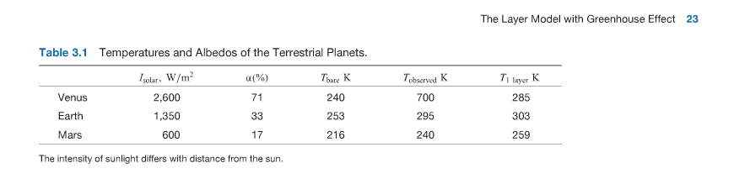
Final points for Chapter 3
Result from bare rock model, this T is more similar to skin T at top of atm
Recorded T Data, not from a model
Result from layer model (w/greenhouse)
Too cold
Pretty close
Too warm
253 x 1.189 = 300

Slide 30
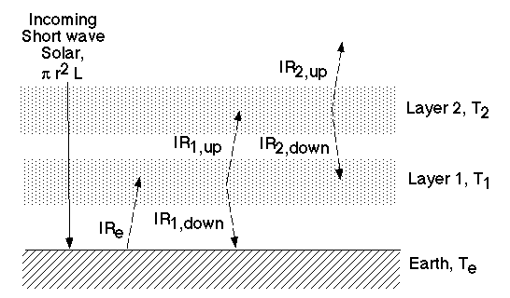
Two Layer Model:

Slide 31
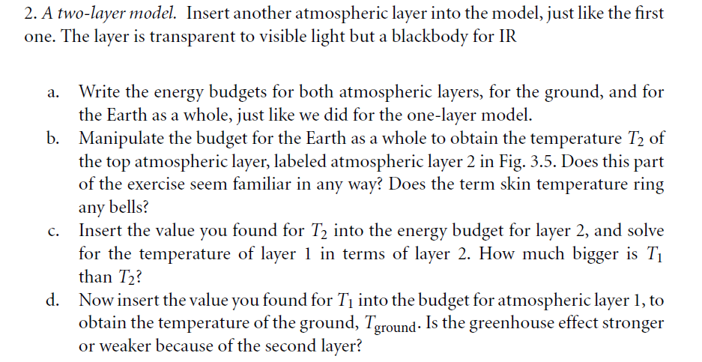
Two Layer Model:

Slide 32
Two Layer Model:

Slide 33
Q3: What if the atmosphere also transmits some of Earth’s radiation?
We found that the Earth is too cold without greenhouse gases, and too warm with them. What’s missing?
Two-layer model: The atmosphere actually does not absorb all of Earth’s radiation – it transmits some of it out into space. This imperfect insulator should result in a slightly cooler surface temperature for the planet.
We can quantify this effect by saying the atmosphere absorbs a fraction a of the Earth’s radiation (E= σ T_{s}⁴), and transmits the rest (1-a). Meanwhile, the atmosphere continues to radiate with an intensity R= σ T_{e}⁴. Let’s see how this changes the results of our thermal equilibrium energy balance analysis.

Slide 34
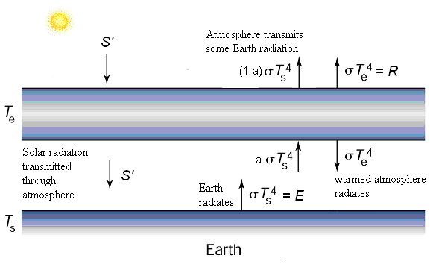
Q3: What if the atmosphere also transmits some of Earth’s radiation?
Top of atmosphere:
S’ = R + (1-a)E
Bottom of atmosphere:
aE = S’ + R
Earth’s surface:
E = S’ + R
Solving any two equations, we find that
assuming T_{s} =288K.
This means that 23% of Earth’s radiation must be transmitted out into space by the insulating atmosphere, if this two-layer model fully explains why the Earth’s surface temperature currently averages about 288K. What other factors might be involved?

Slide 35
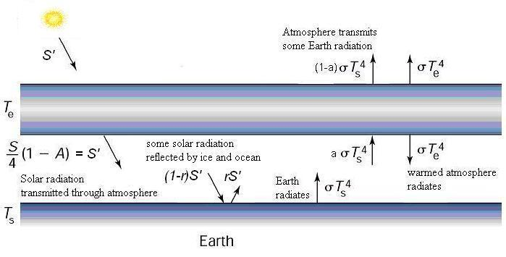
Q4: What is the effect of ocean and ice albedo on Earth’s global energy balance?
We actually included some reflection (r) from the Earth’s surface in our original albedo term (A). Surface albedo is complicated, however, by several factors, including (1) seasonal changes and (2) positive feedback effects.

Slide 36
Take Home Points
The outflow of IR energy from a planet must balance heating from the Sun.
The planet accomplishes this balance by adjusting its temperature.
Absorption of outgoing IR by the atmosphere warms the surface of the planet, as the planet strives to balance its energy budget

